Slide 1
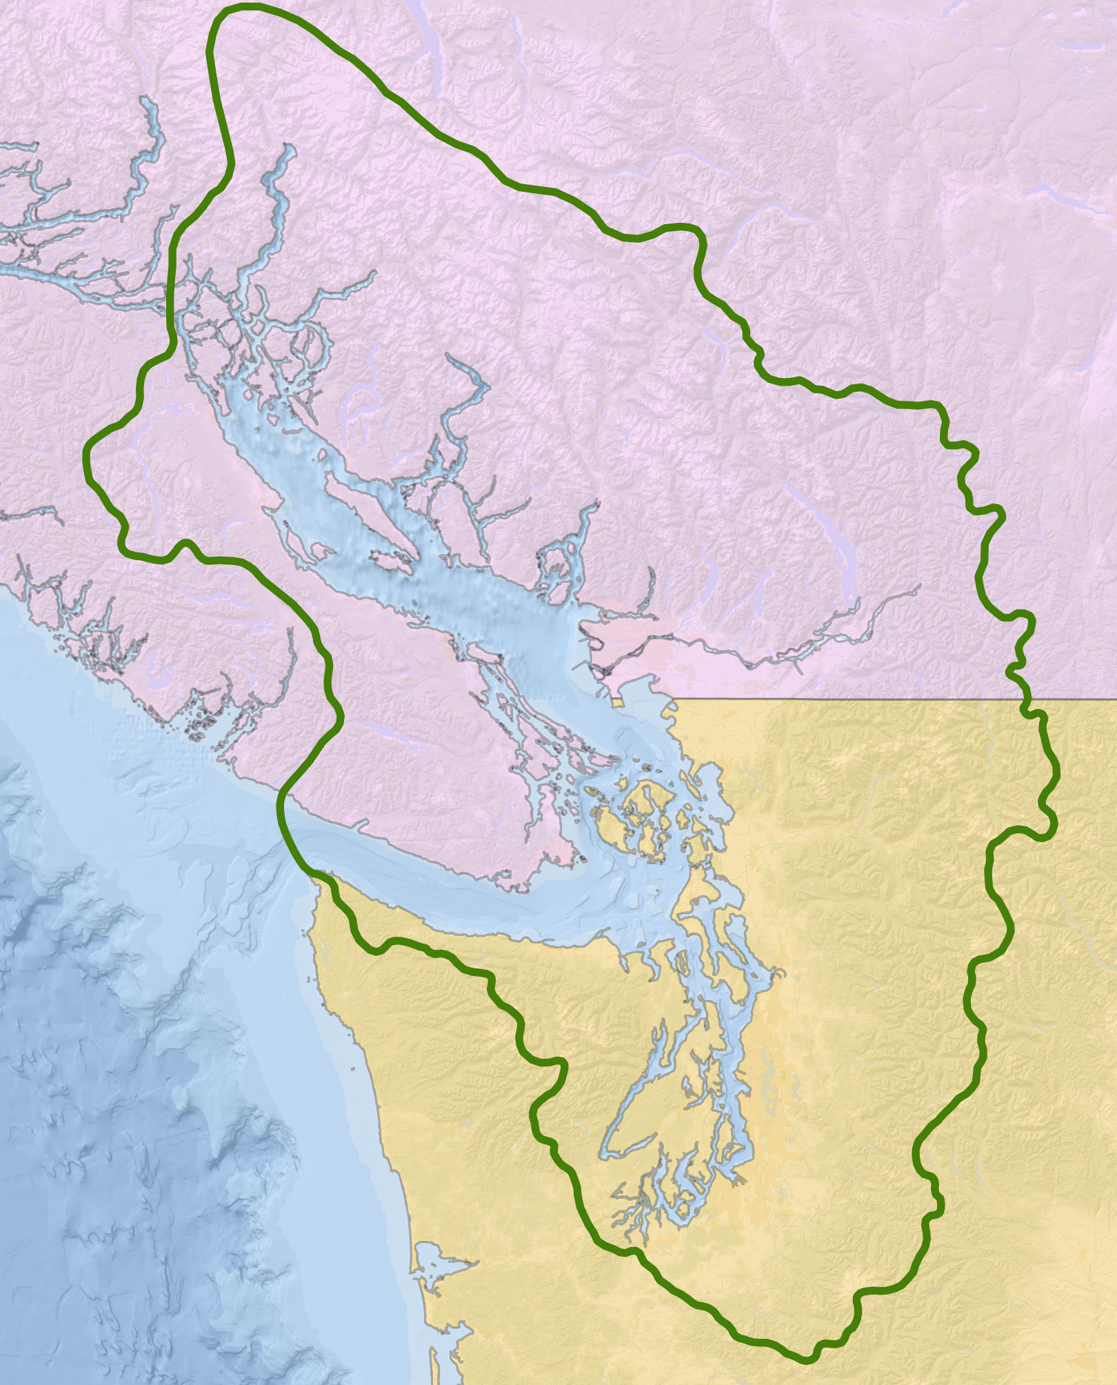
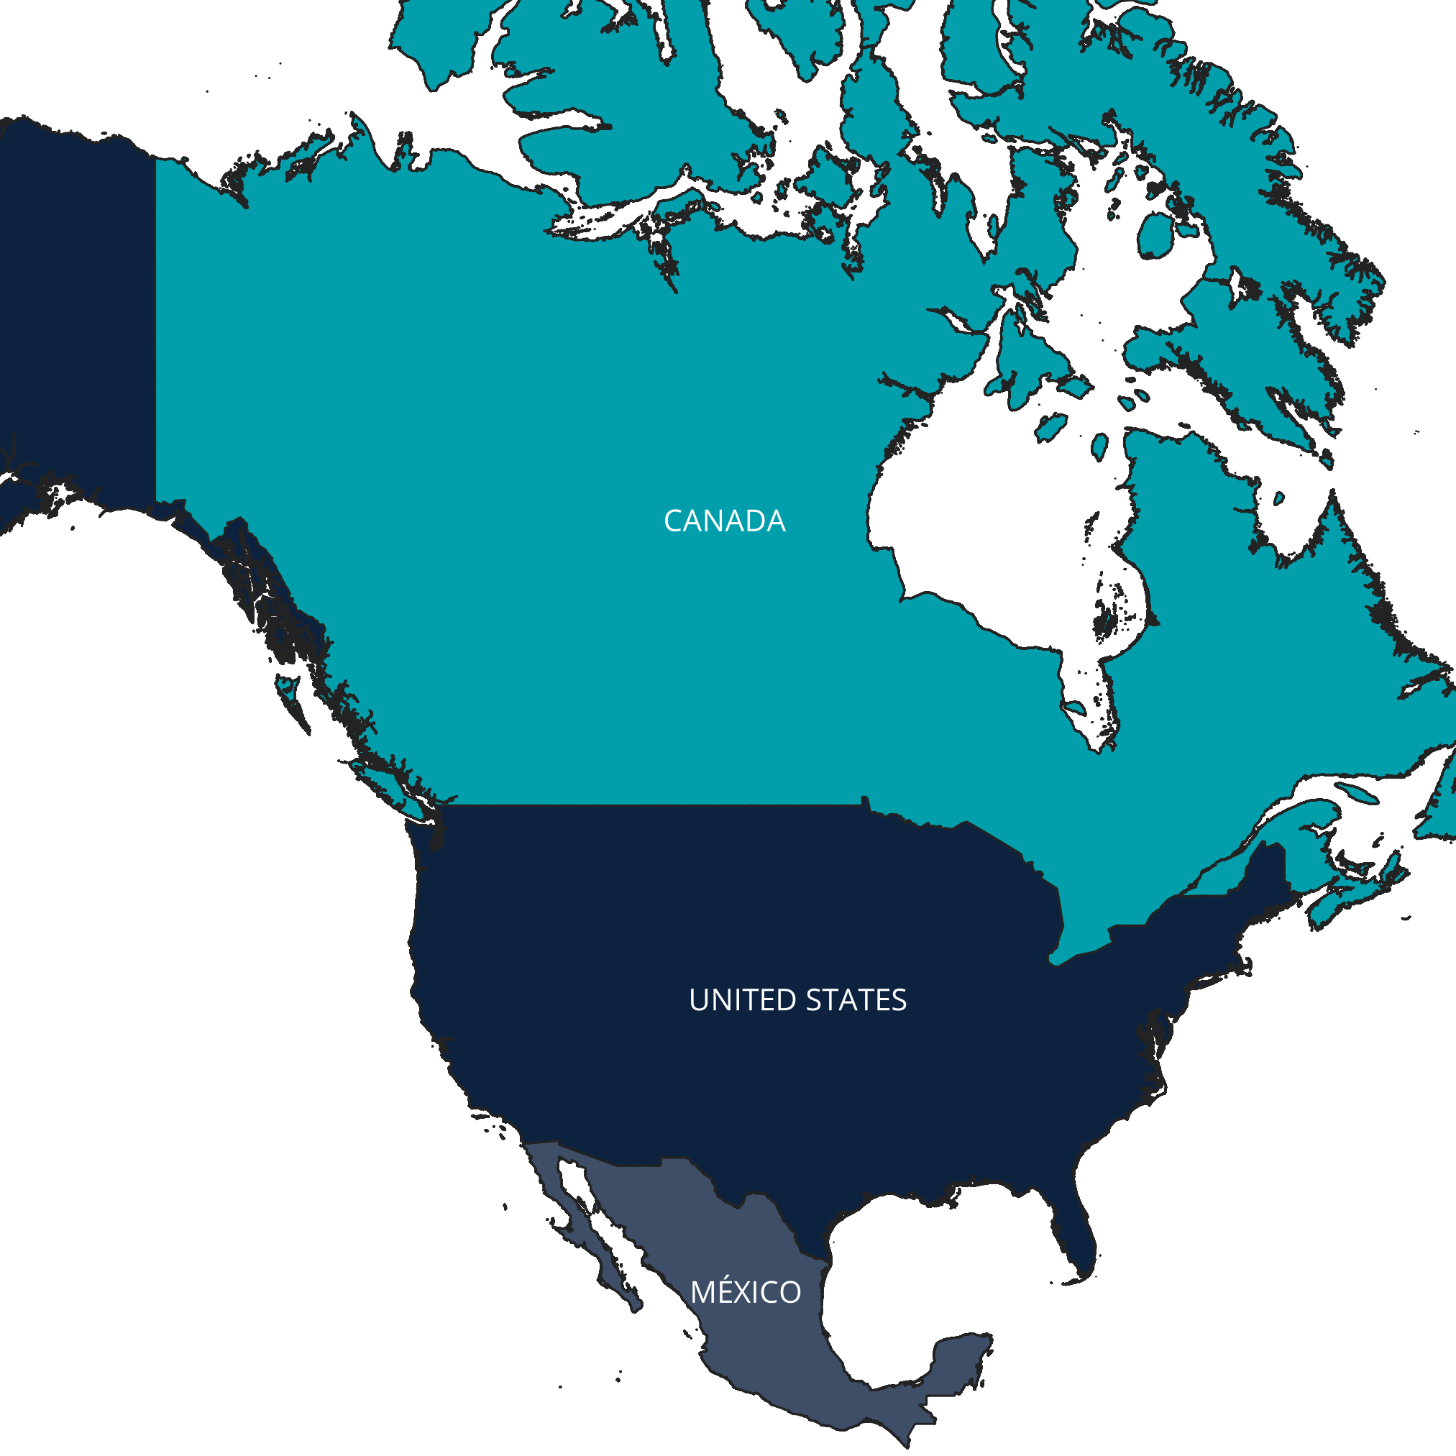
A
British Columbia
Qualicum
Beach
Vancouver
Nanaimo
Seattle
Washington
Notes:
Country map INSET = gadm41_CAN_0 … w/ custom select colors
Salish Sea outline = salish_sea_basin_boundary, basemap = ESRI Ocean & gadm41_CAN_1

Slide 2
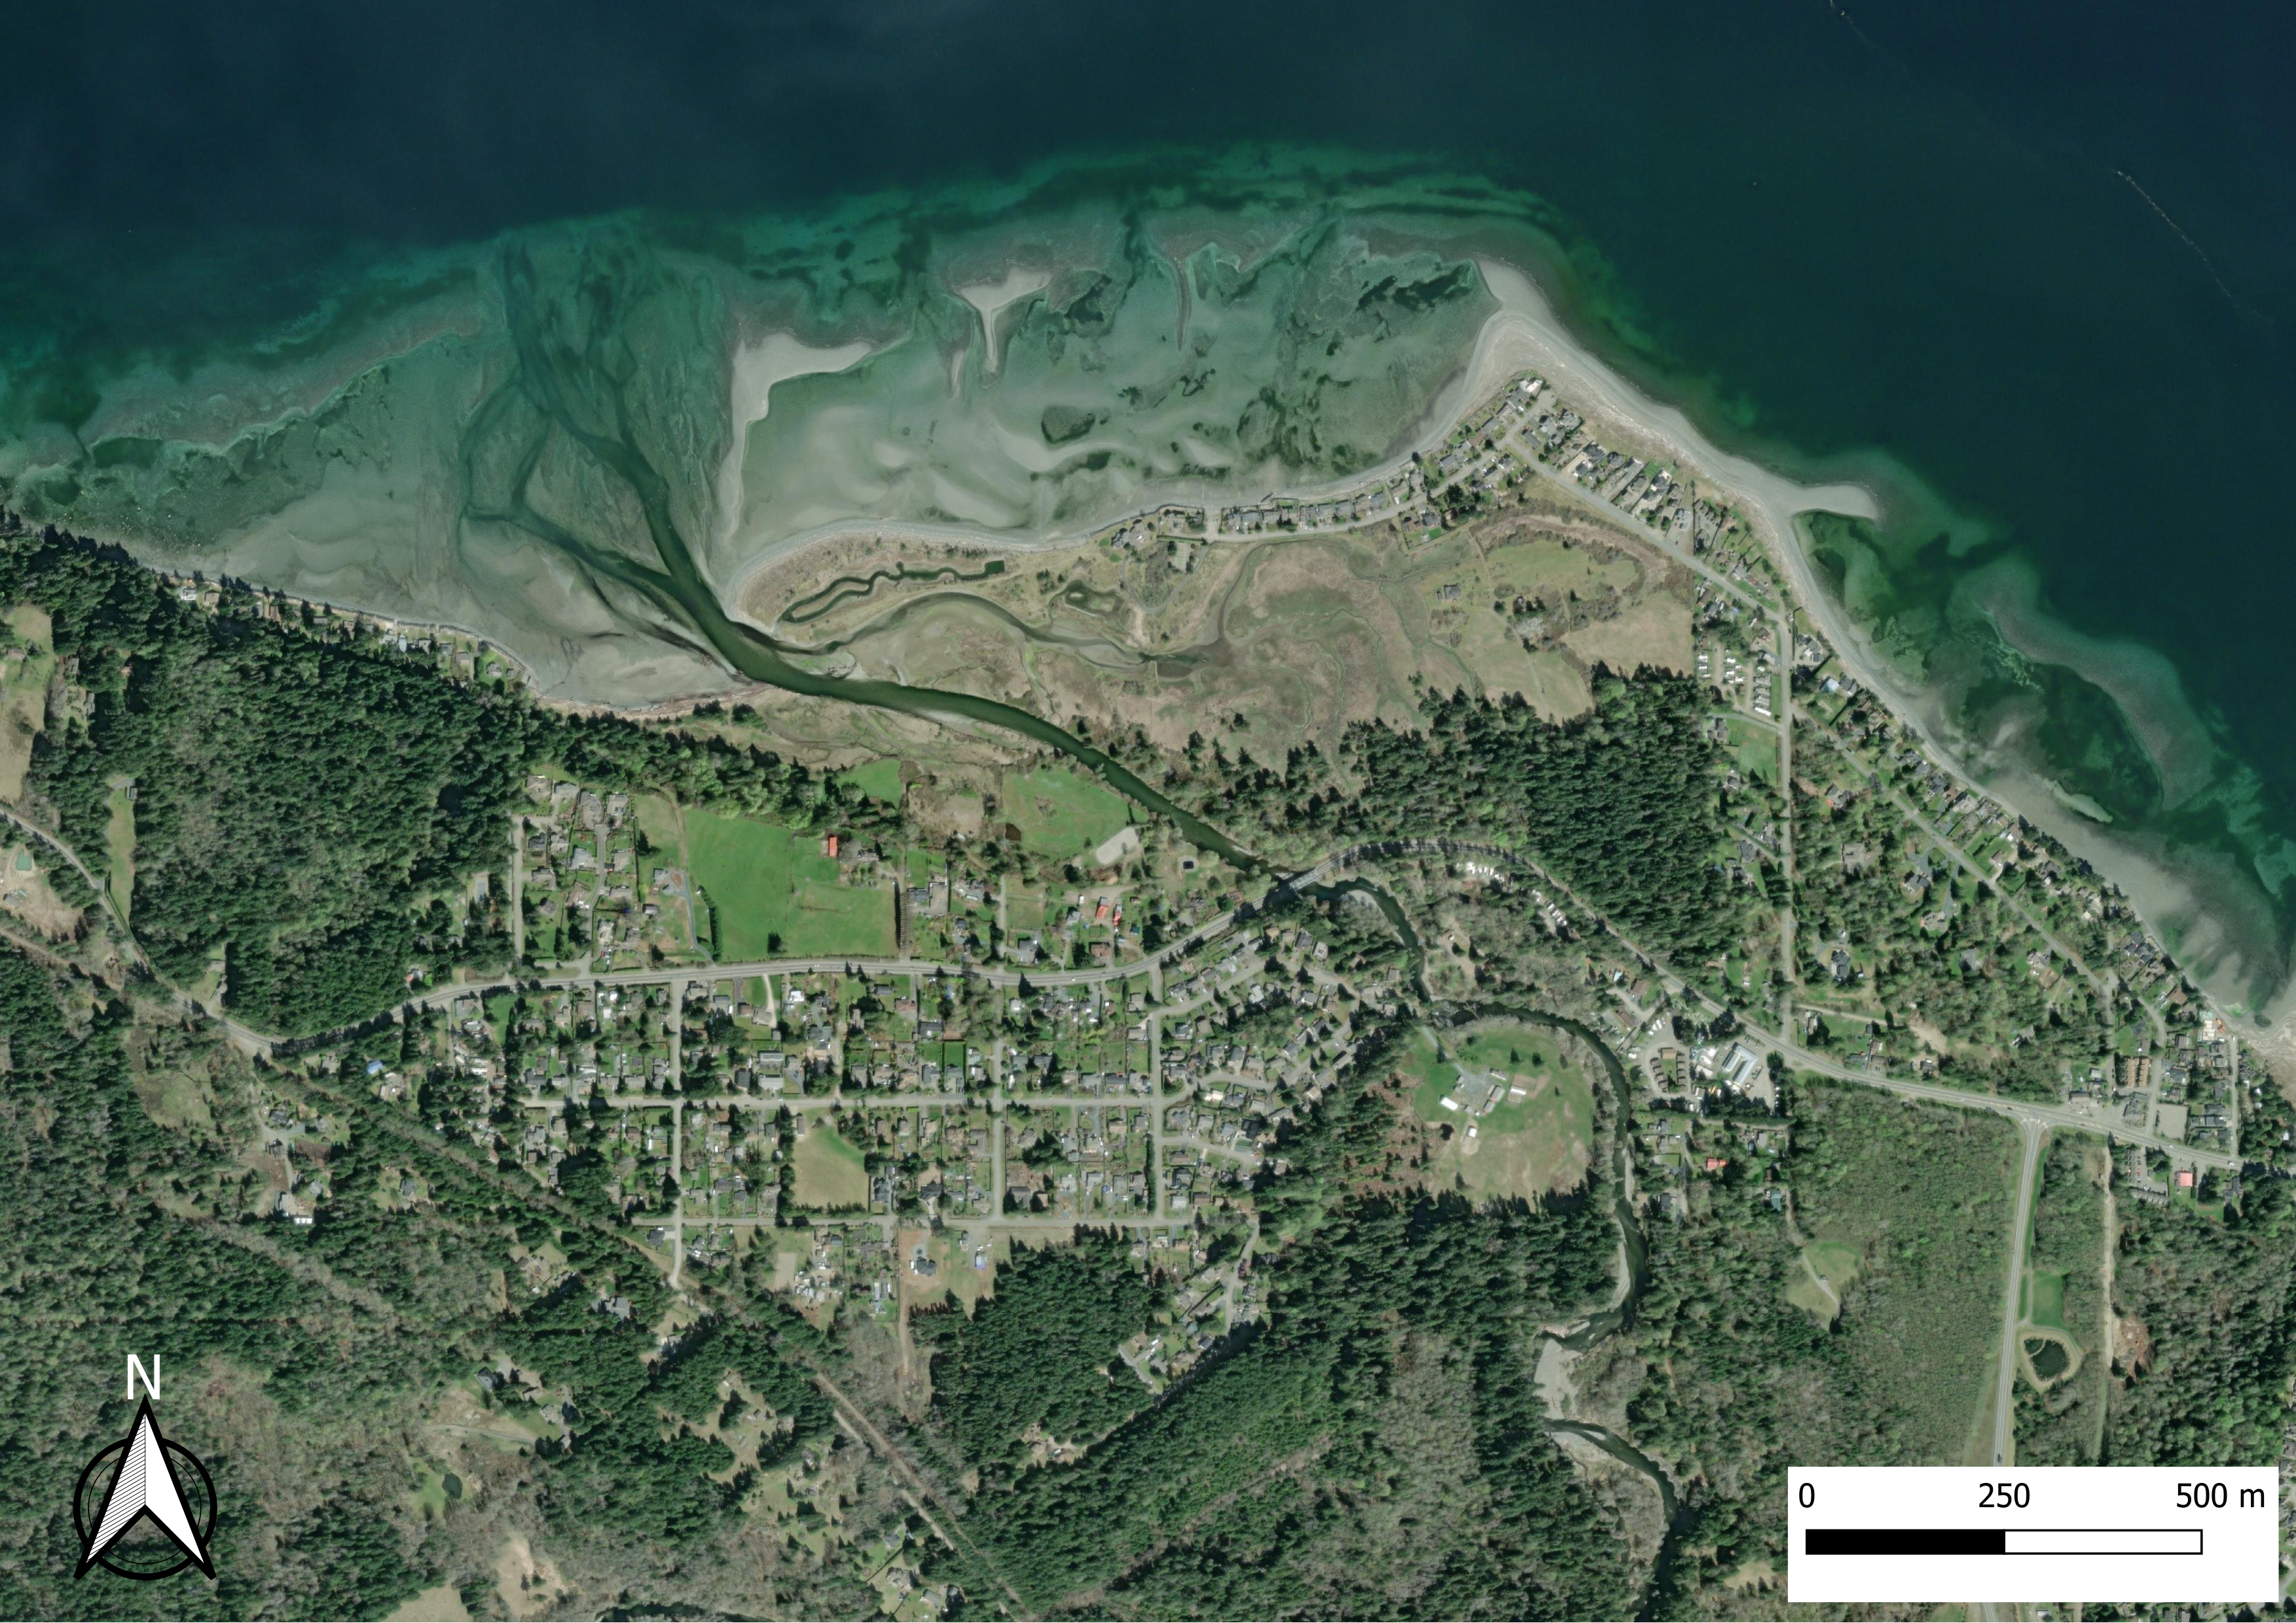
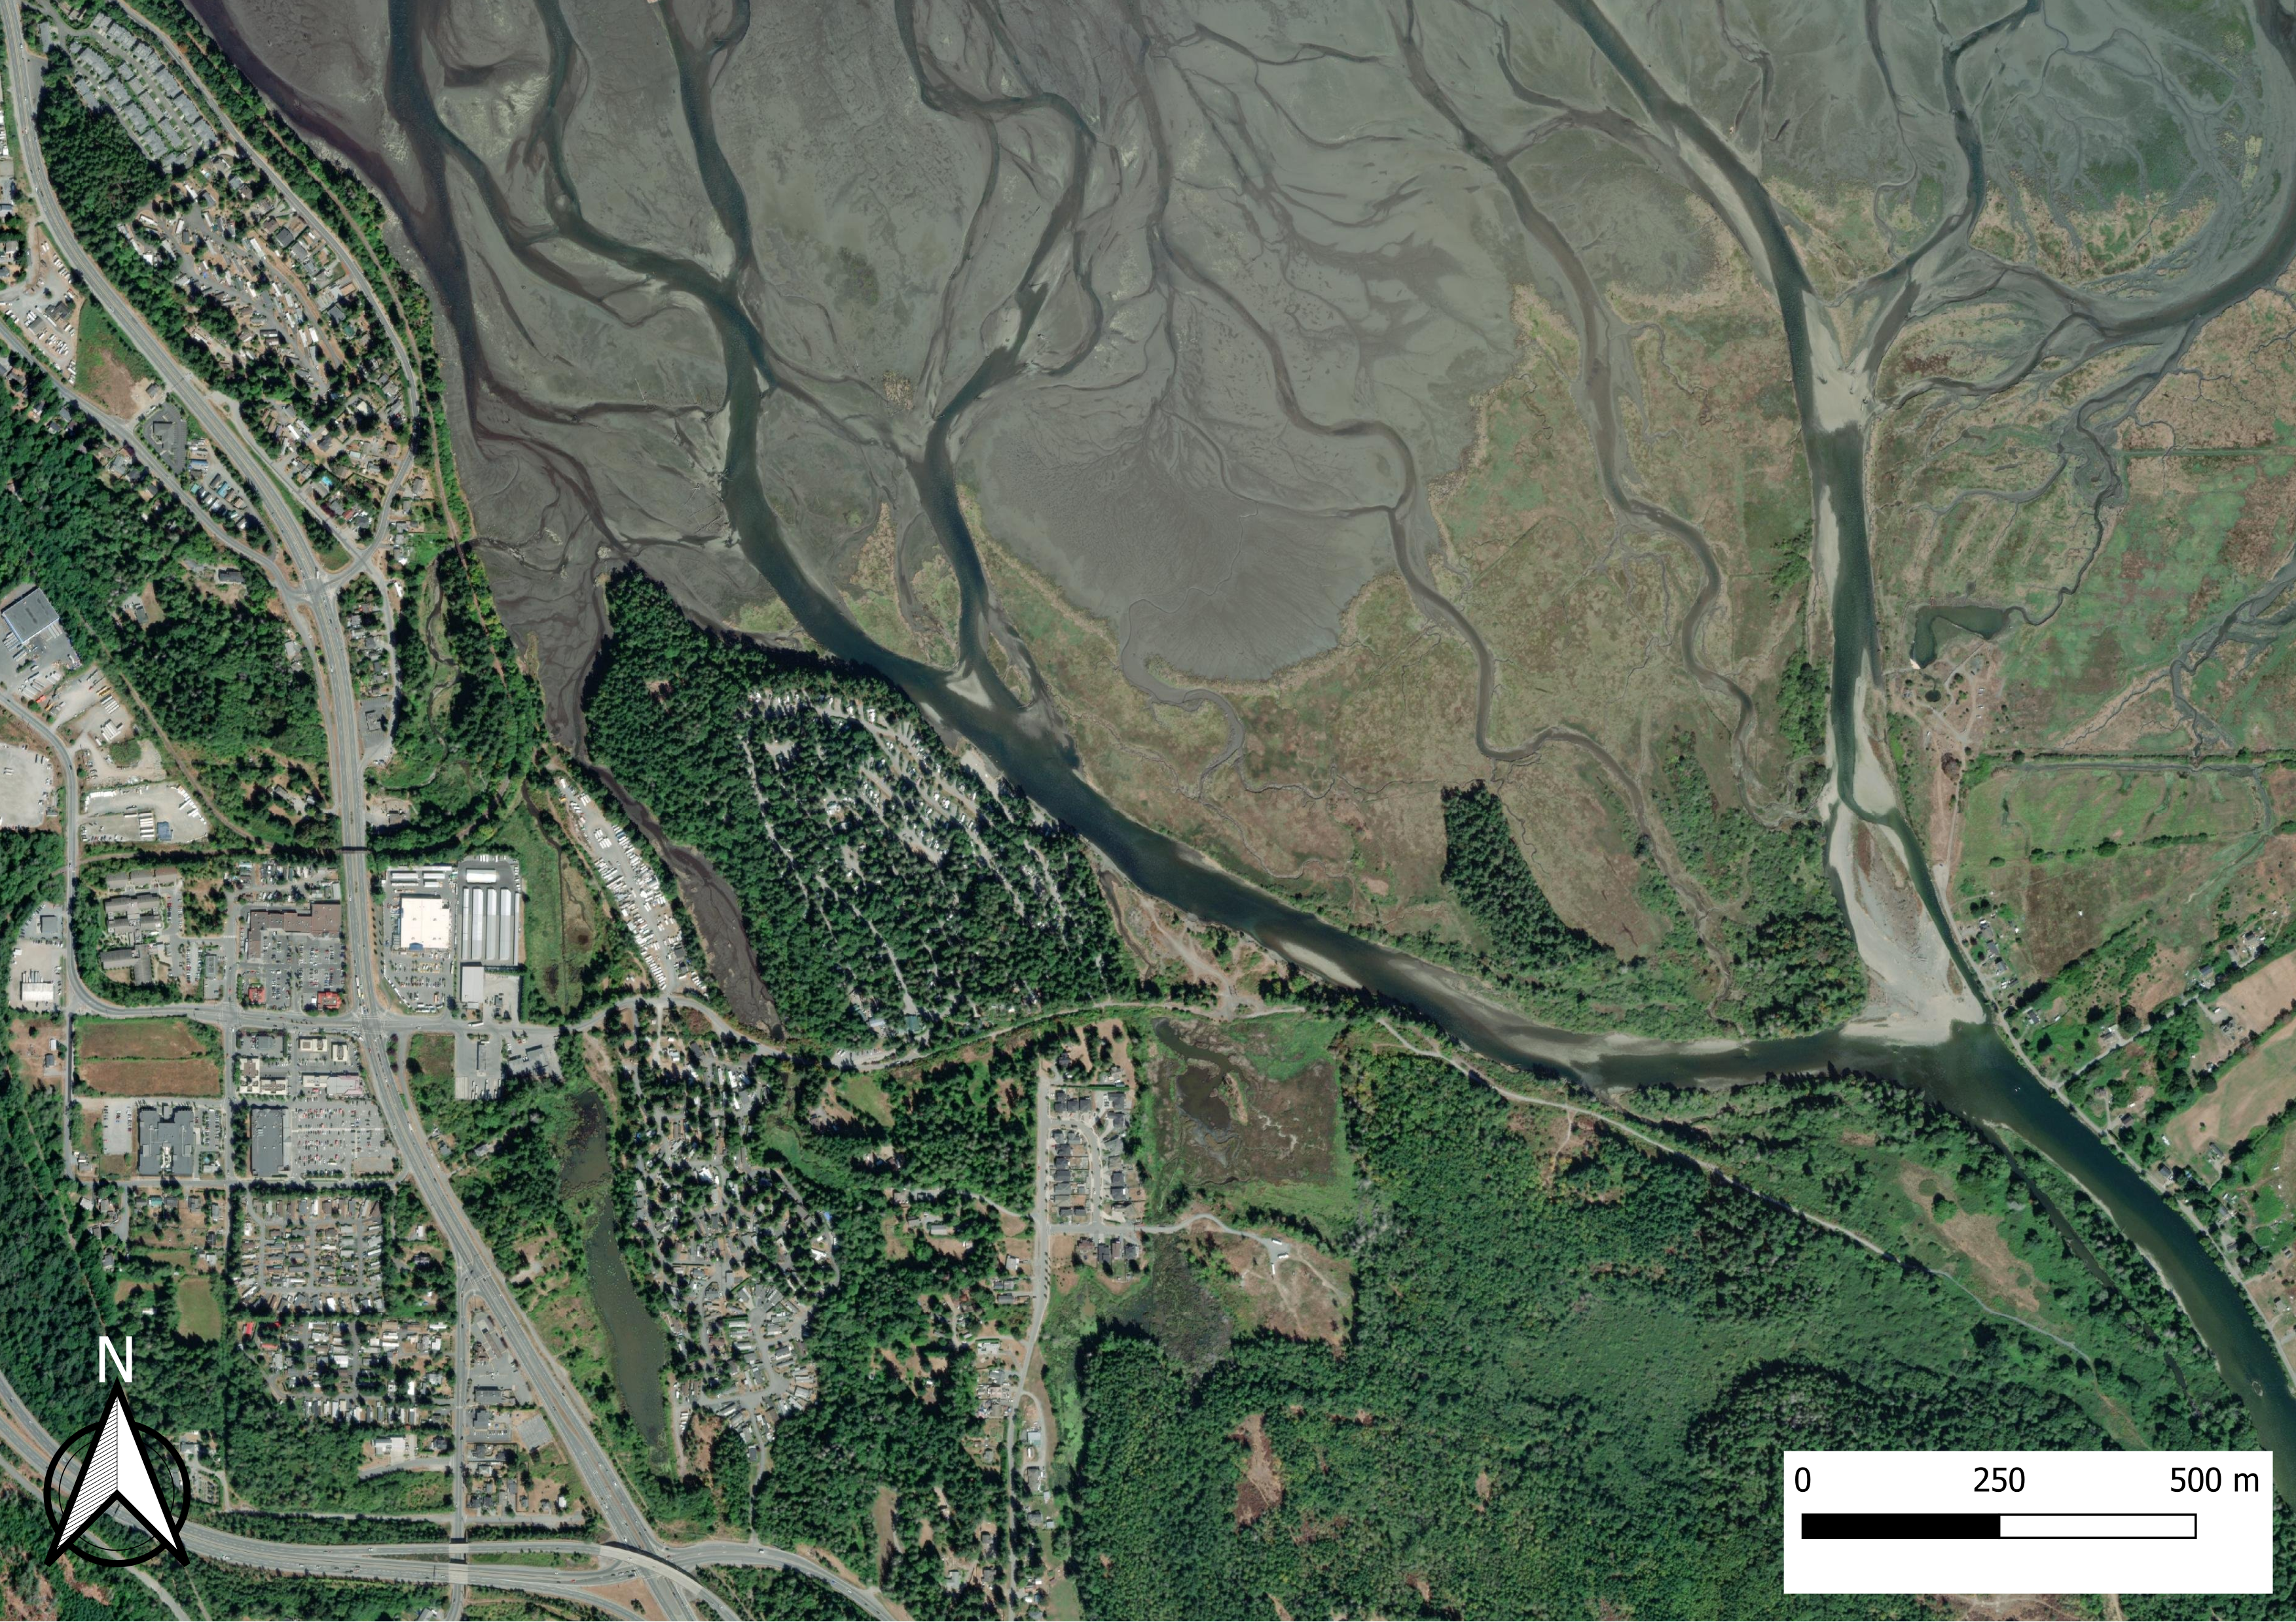
B
C

Slide 3
A
British Columbia
B
Qualicum
Beach
Vancouver
Nanaimo
C
Seattle
Washington

Slide 4
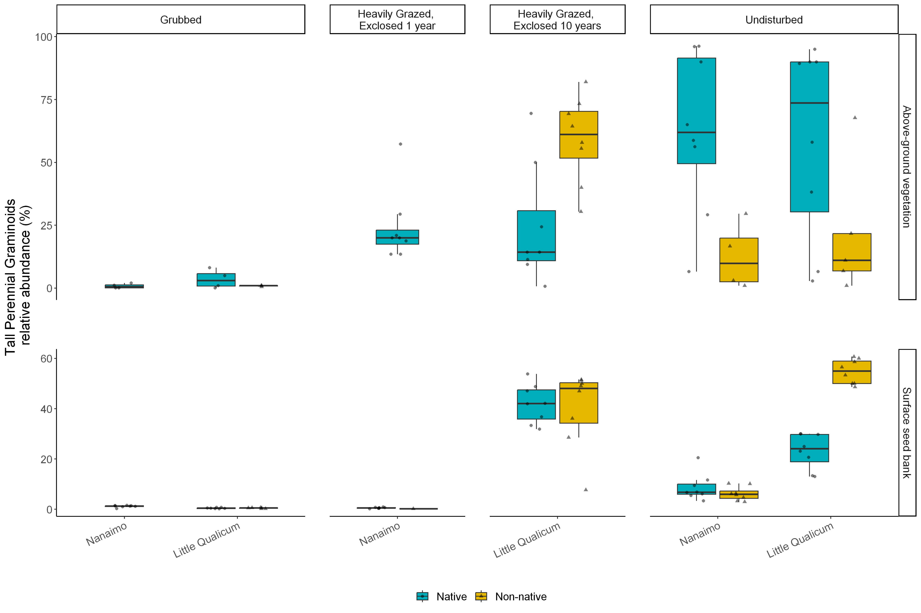

Slide 5
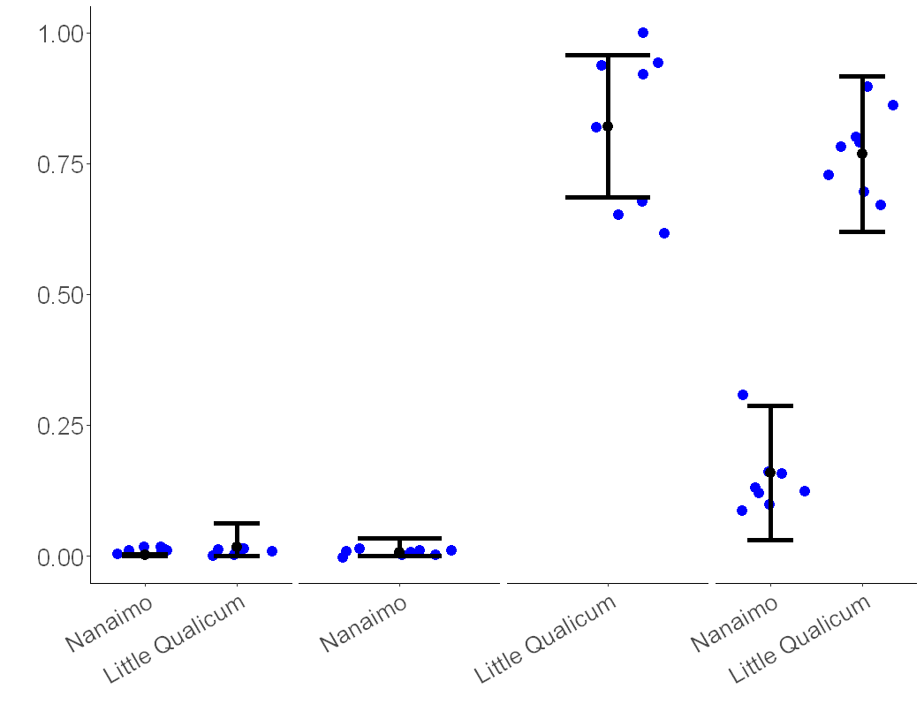

Slide 6
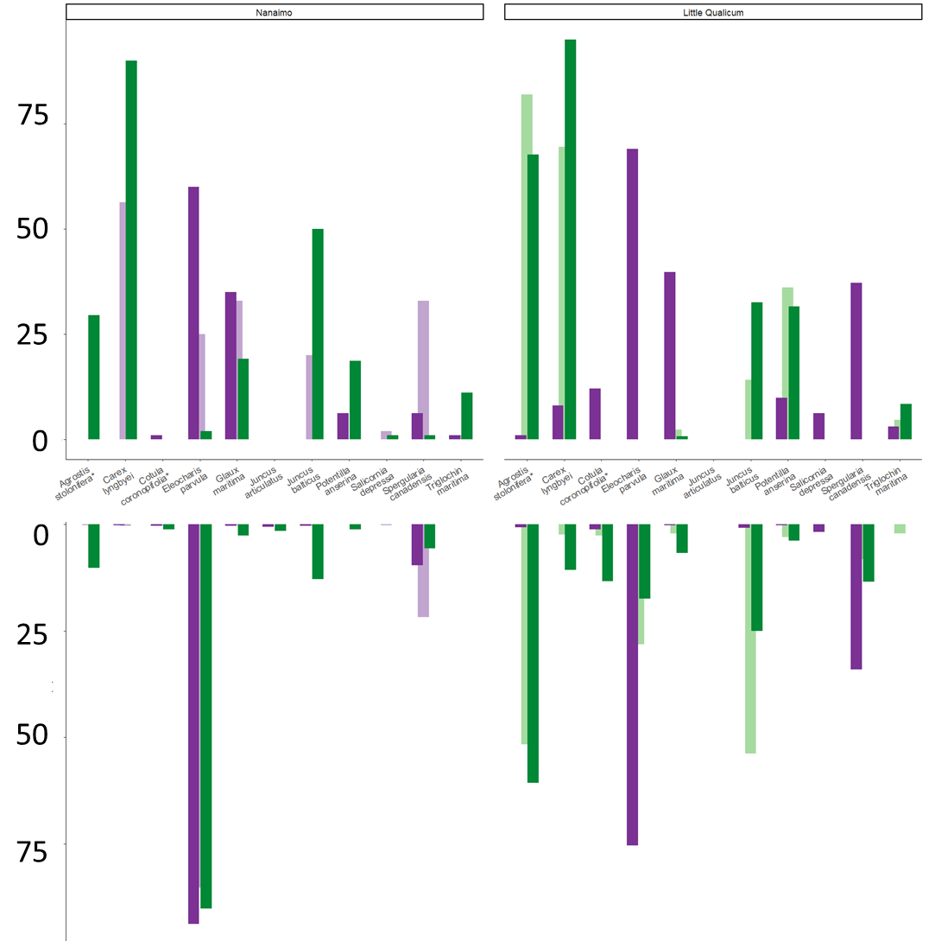
Nanaimo
Little Qualicum
Grubbed
1-year old exclosures
10-year old exclosures
Undisturbed
Above-ground
Vegetation
Relative Abundance (%)
*As
Cl
*Cc
Ep
Gm
Ja
Jb
Pa
Sd
Sc
Tm
*As
Cl
*Cc
Ep
Gm
Ja
Jb
Pa
Sd
Sc
Tm
Non-native |  | Species
* | As | Agrostis stolonifera
 | Cl | Carex lyngbyei
* | Cc | Cotula coronopifolia
 | Ep | Eleocharis parvula
 | Gm | Glaux maritima
 | Ja | Juncus articulatus
 | Jb | Juncus balticus
 | Pa | Potentilla anserina
 | Sd | Salicornia depressa
 | Sc | Spergularia canadensis
 | Tm | Triglochin maritima
Surface
Seed Bank

Slide 7
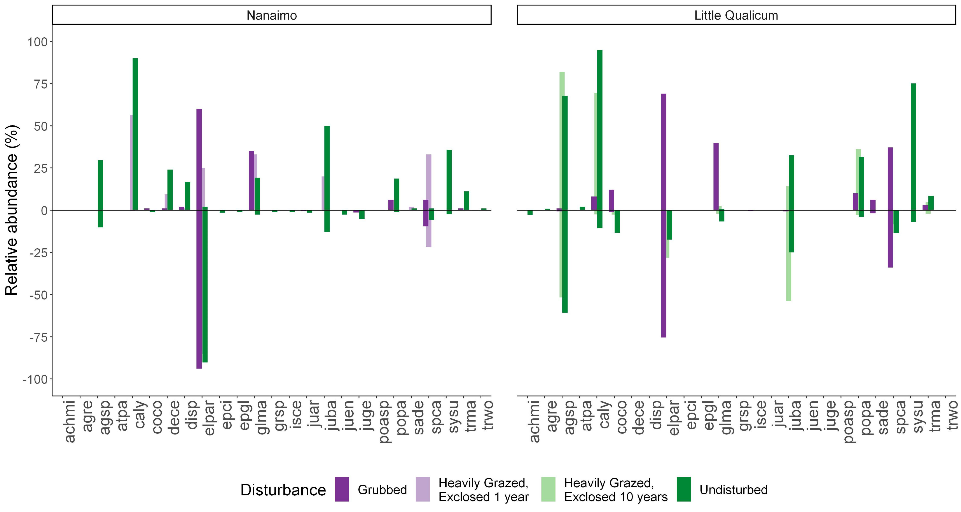
Above-ground
vegetation
Relative Abundance (%)
Surface seed bank

Slide 8
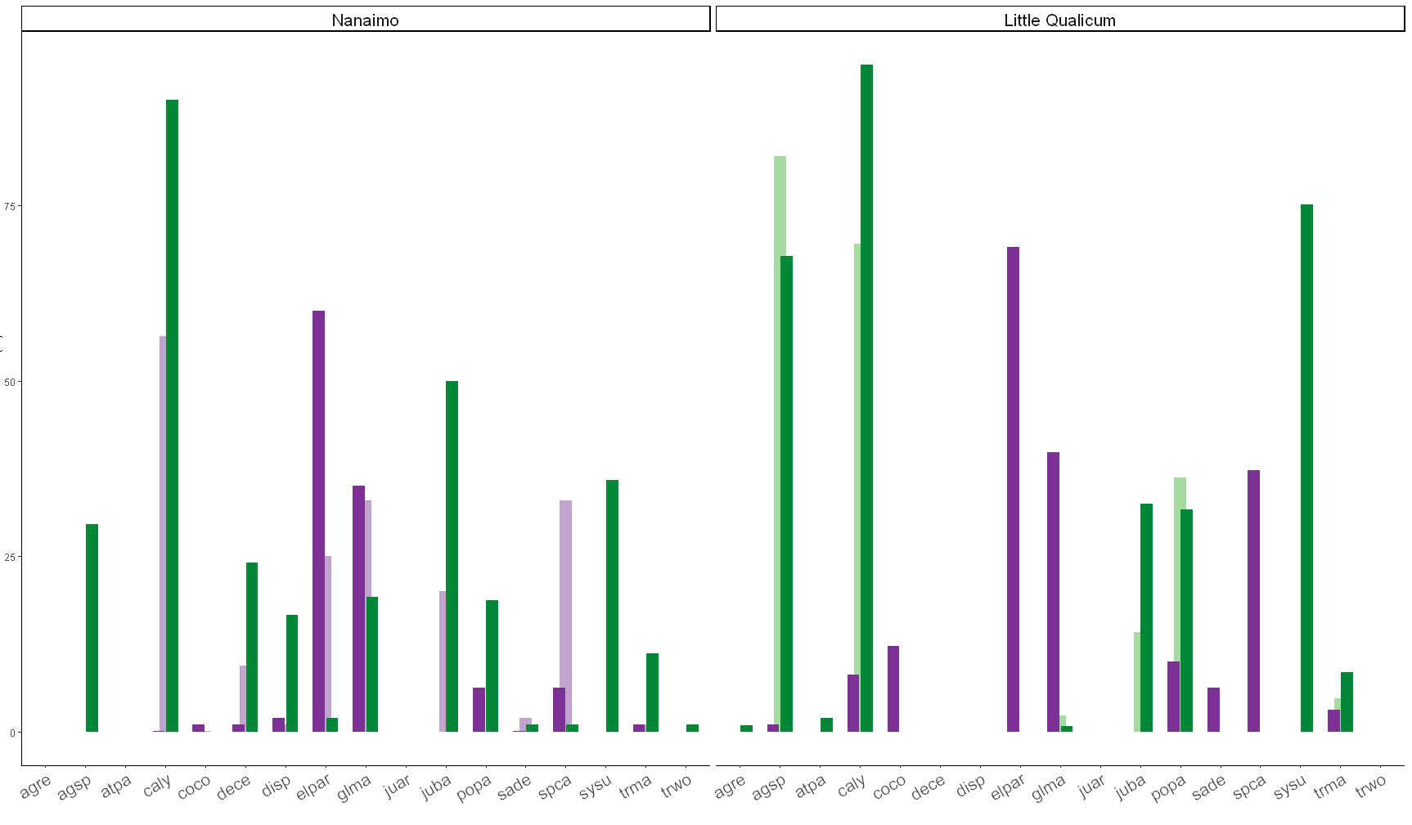

Slide 9
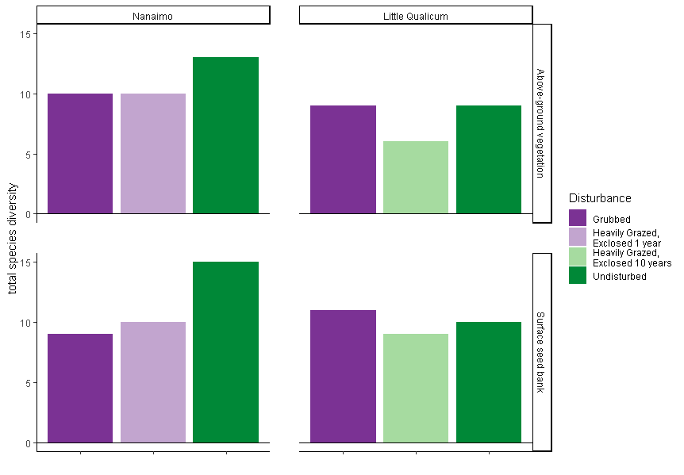
Above Ground Vegetation |  |  |  | Below Ground Seed Bank
Disturbance | Species | p-value |  | Disturbance | Species | p-value
Grubbed | Eleocharis parvula | < 0.01 |  | Grubbed | Salicornia depressa | 0.01
 | Cotula coronopifolia* | 0.04
Grubbed + 1-year old exclosures | Spergularia canadensis | < 0.01 |  | Grubbed + 1-year old exclosures | Eleocharis parvula | 0.02
 | Glaux maritima | 0.03 |  |  | Spergularia canadensis | 0.03
10-year old exclosures | Agrostis stolonifera*⁺ | < 0.01 |  | 10-year old exclosures | Juncus balticus⁺ | < 0.01
 |  |  |  |  | Triglochin maritima | 0.05
10-year old exclosures + Undisturbed | Potentilla pacifica | < 0.01 |  | 10-year old exclosures + Undisturbed | Agrostis stolonifera*⁺ | < 0.01
Undisturbed | Juncus balticus⁺ | 0.02 |  | Undisturbed | Carex lyngbyei⁺ | 0.02
 | Carex lyngbyei⁺ | 0.02 |  |  | Cotula coronopifolia* | 0.03
 | Triglochin maritima | 0.04 |  |  | Juncus articulatus⁺ | 0.04
Disturbance | Above-ground Vegetation | Surface Seed Bank
Grubbed | 11 | 15
1-year old exclosures | 10 | 10
10-year old exclosures | 6 | 9
Undisturbed | 15 | 17

Slide 10
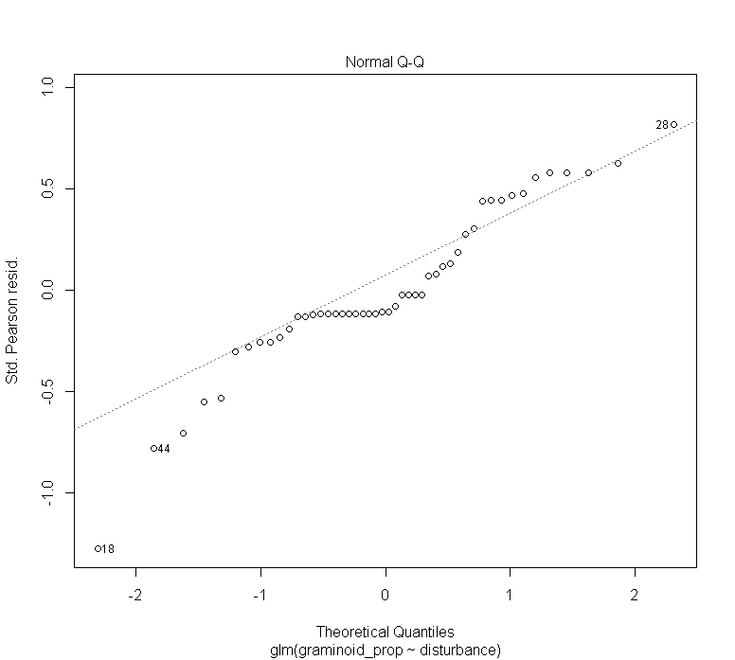
Above-ground vegetation

Slide 11
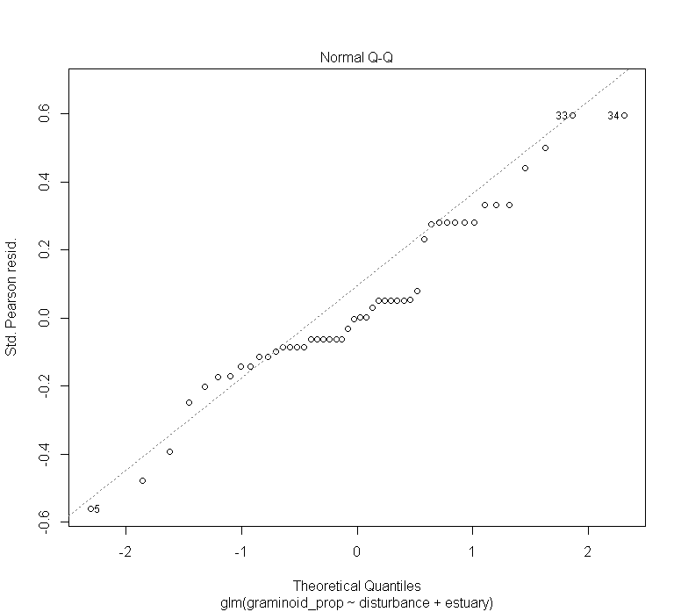
Surface Seed Bank

Slide 12
Above-ground vegetation
Surface Seed Bank

Slide 13
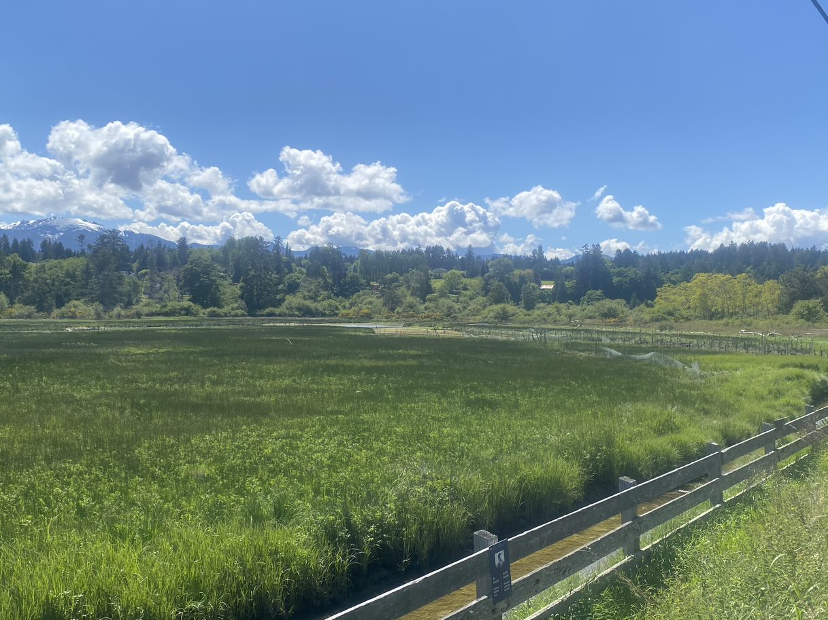
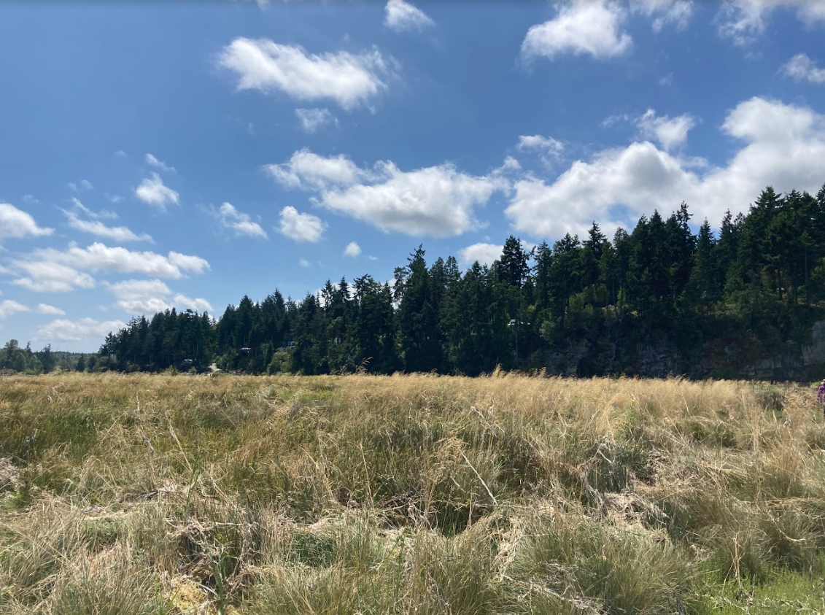
A
B
Ungrazed marsh platform in LQRE; note vegetation continuity to edge of wetted channel width, exclosures in background protect vegetation as geese progressively graze upstream from tidal front. Photo credit: Dawson Clermont, 2021.

Slide 14
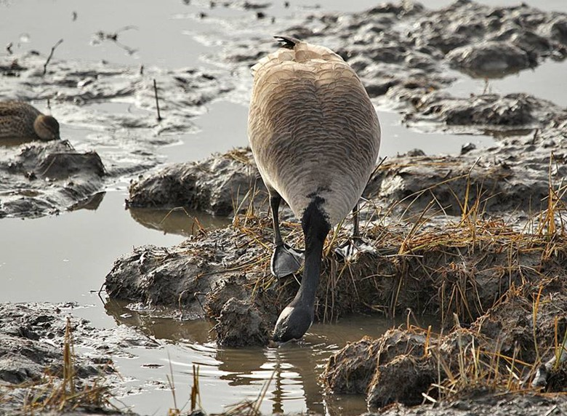
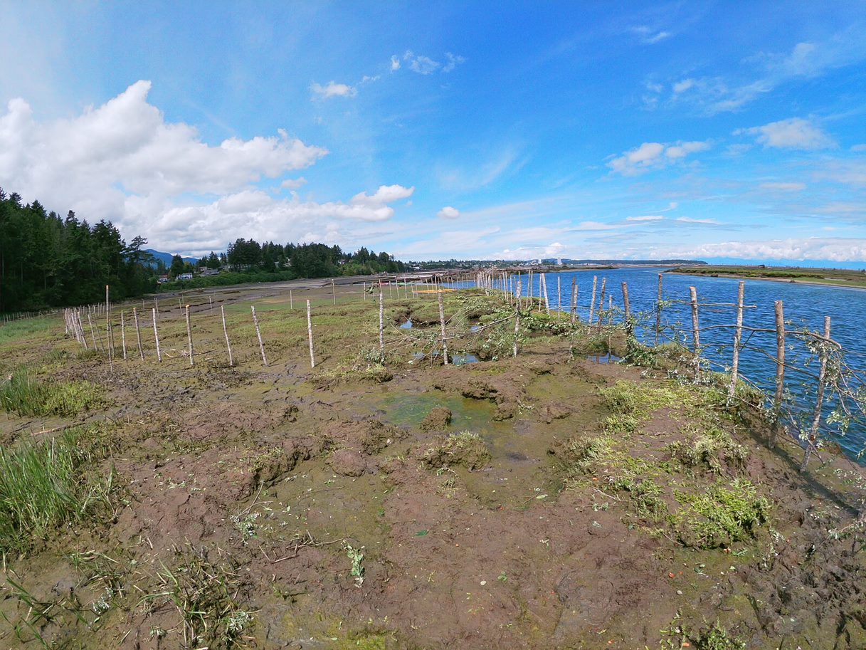
C
D
(left) Canada goose (Branta canadensis) exhibiting grubbing behavior in a heavily impacted area, with loss of sediment of consolidation. Photo credit: Gerry Fairbrother, date unknown.
(right) Extensive grubbing damage in NRE, all-natural exclosures being constructed prior to transplanting to protect new plants. Photo credit: Garreth Ashely, 2021.

Slide 15
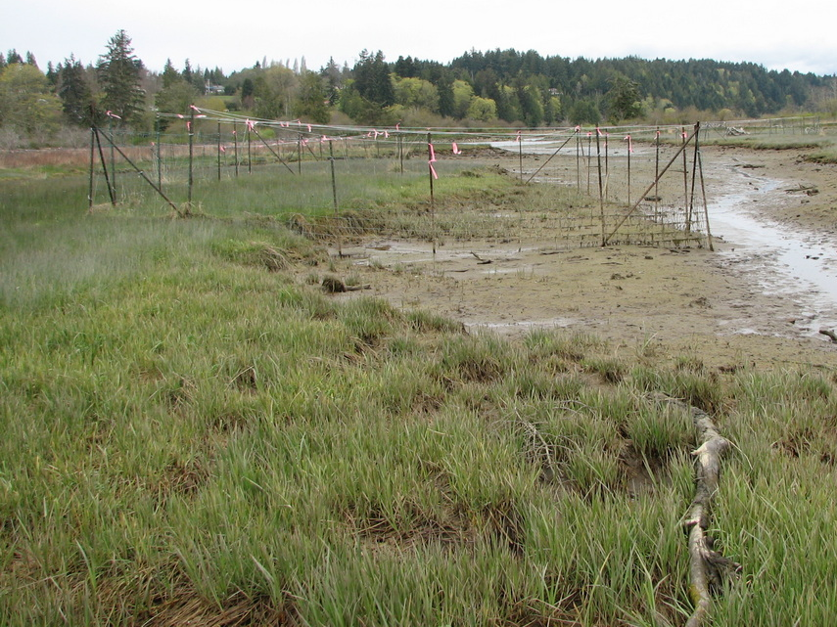
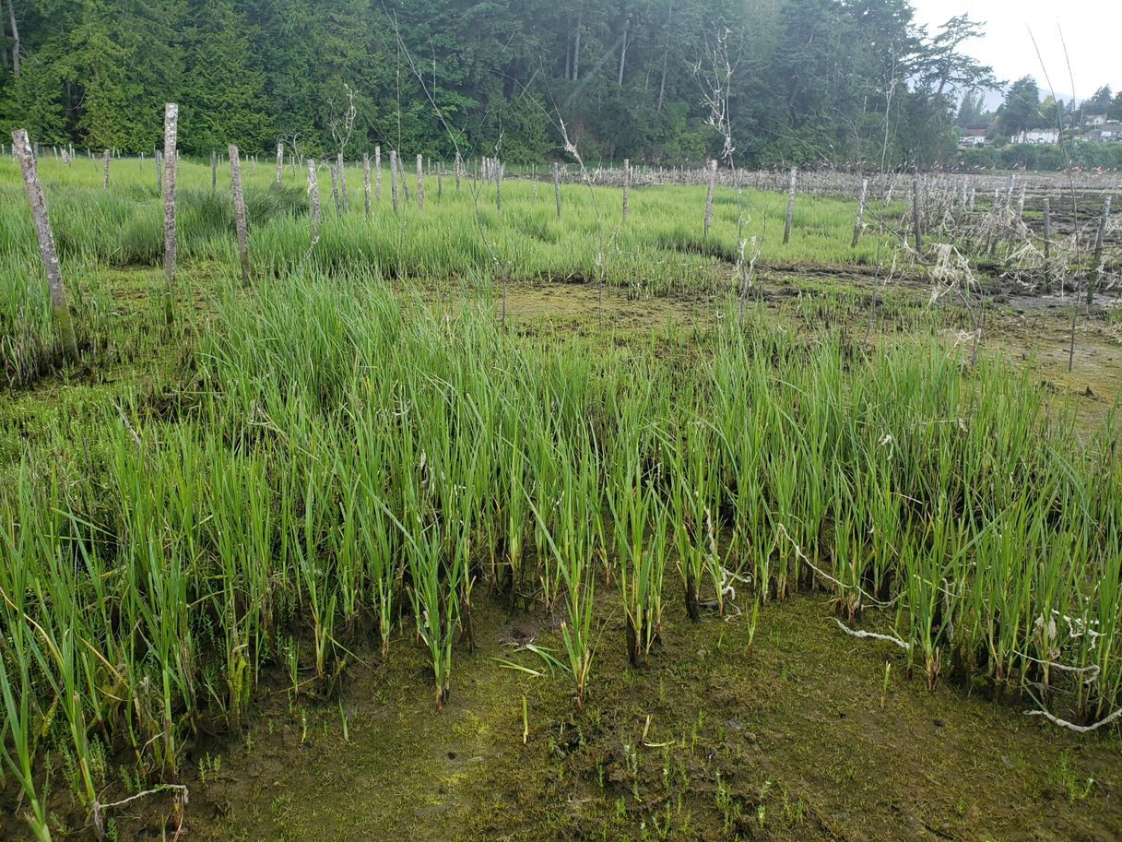
E
F
Apr. 2011, 1 year after exclosure construction in LQRE; new growth in foreground does not yet appear grazed. Note extensive grubbing in mid-foreground with remnant shoots, and extensive vegetation loss in background along channel.
Photo credit: Neil Dawe, 2011
New construction of all-natural fencing surrounding a recovering stand of CALY. Note recent herbivory evident at tips of sedge leaf blades. NRE, exclosures constructed 2020; photo credit: Tim Clermont

Slide 16
A
B
C
D
E
F

Slide 17
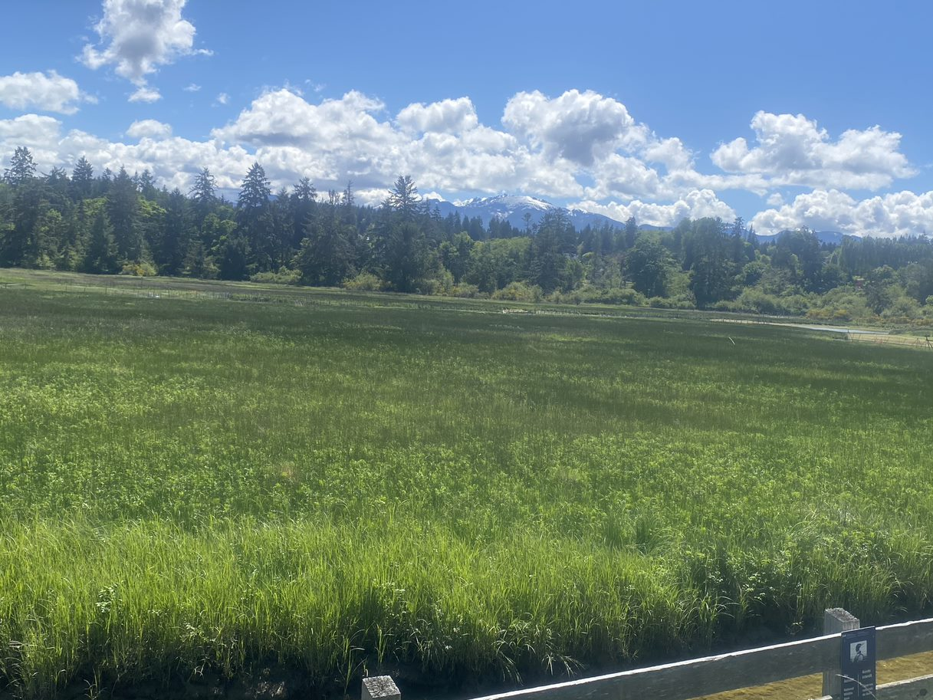
Ungrazed marsh platform in LQRE; note vegetation continuity to edge of wetted channel width, exclosures in background protect vegetation as geese progressively graze upstream from tidal front. Photo credit: Dawson Clermont, 2021.

Slide 18
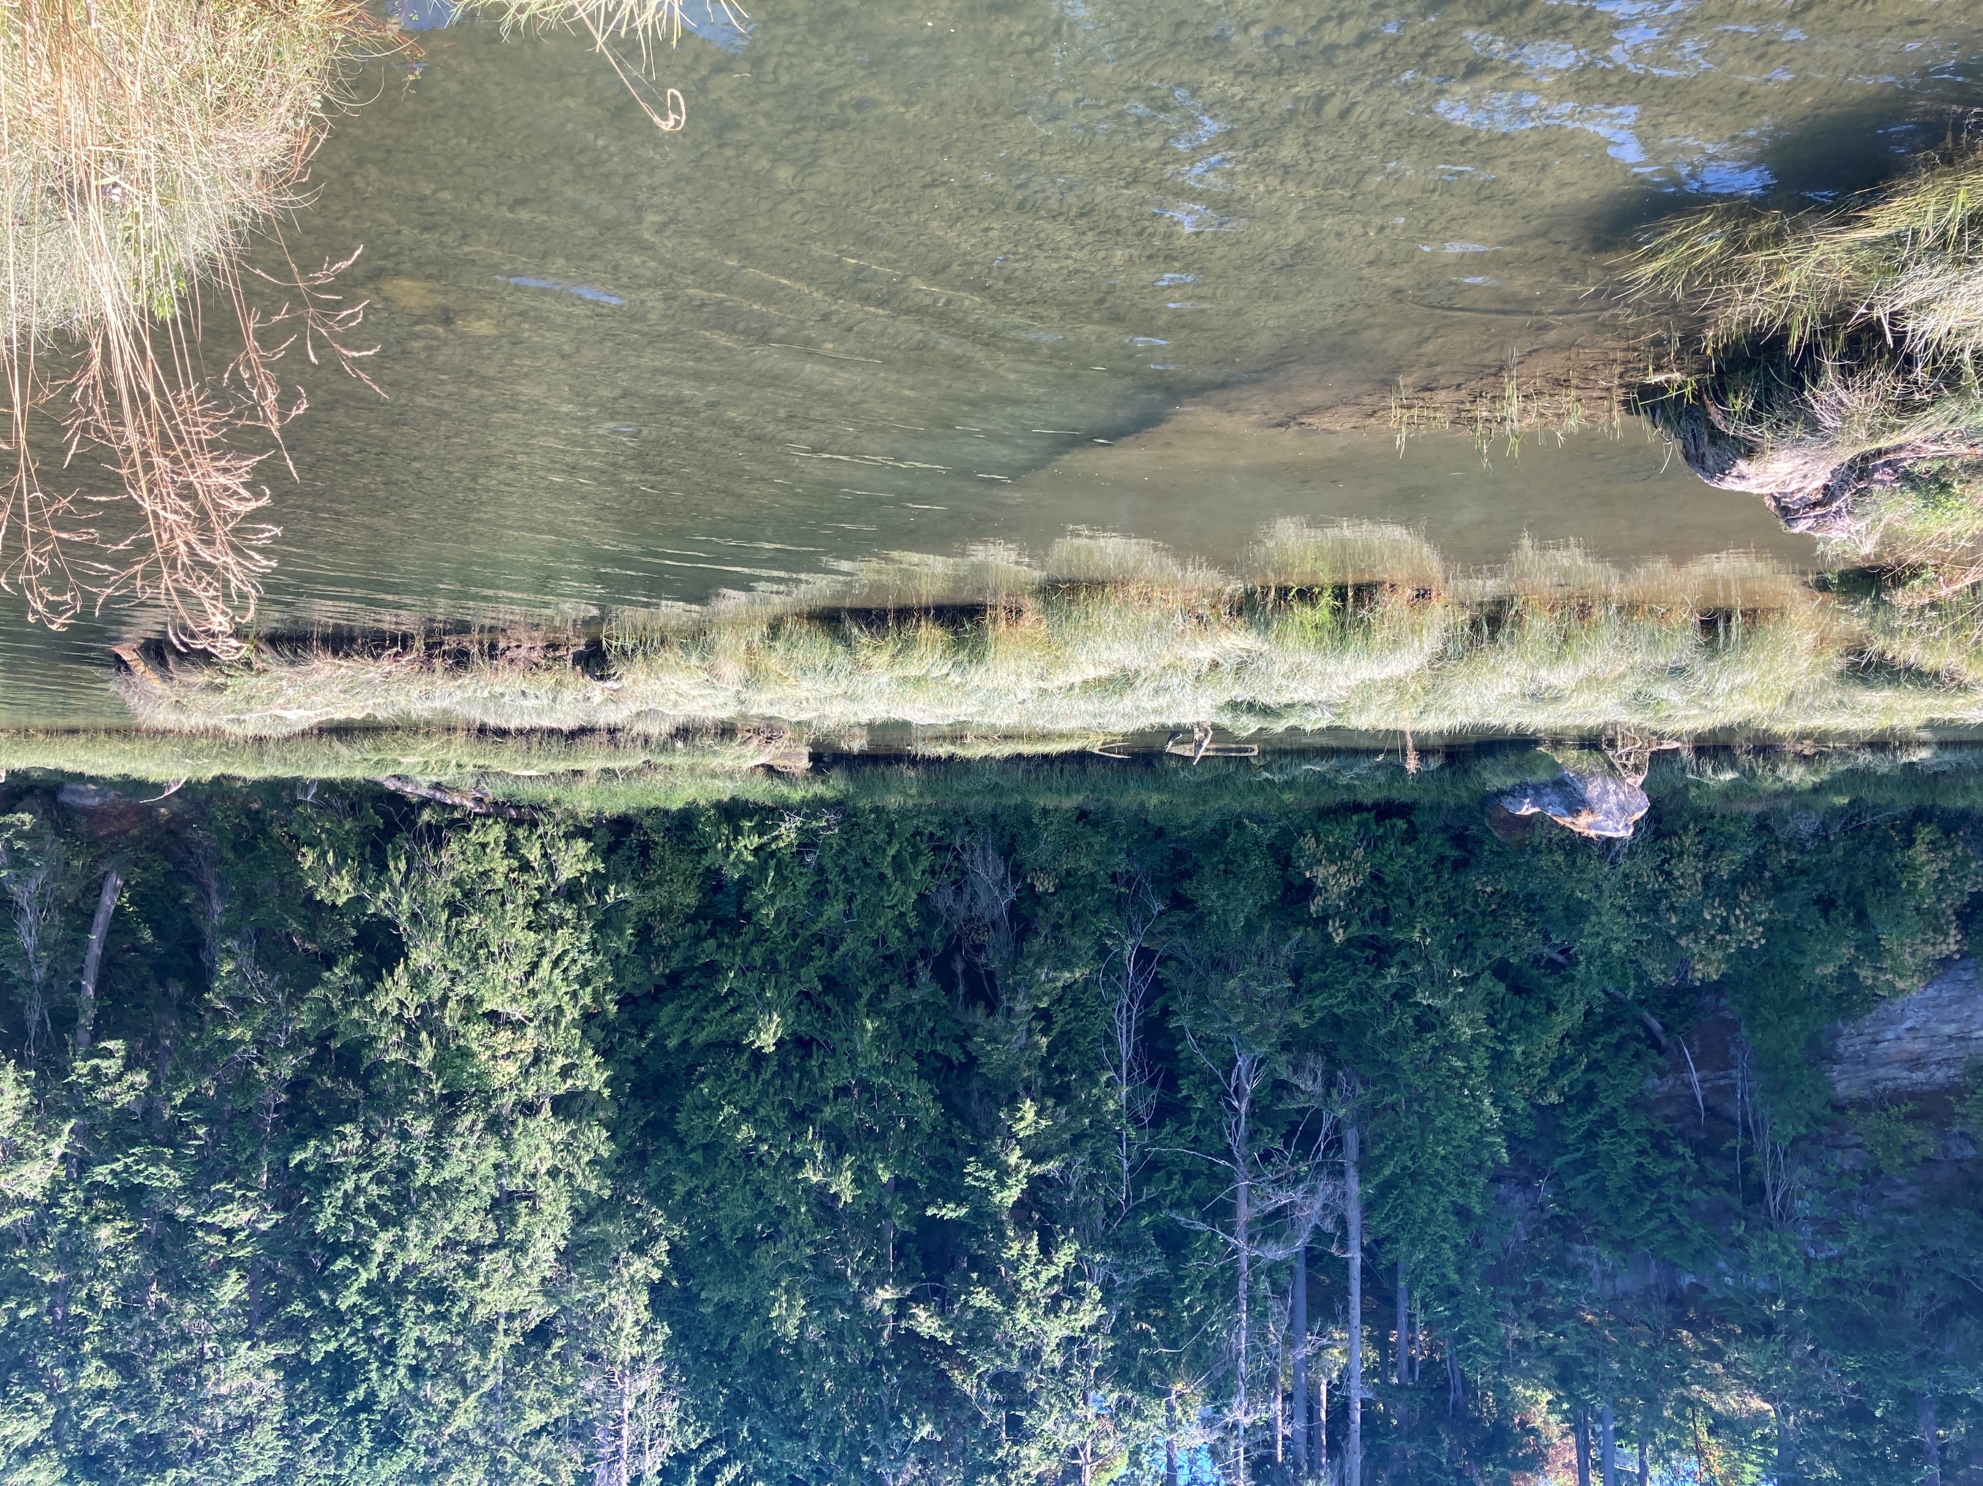
(left) Ungrazed “reference” sward of C. lyngbyei at high tide in Nanaimo River Estuary; note patch of D. caespitosa in foreground. (right) Ungrazed “reference” area dominated by D. caespitosa and J. balticus. Photo credit: S. Lane, 2021

Slide 19
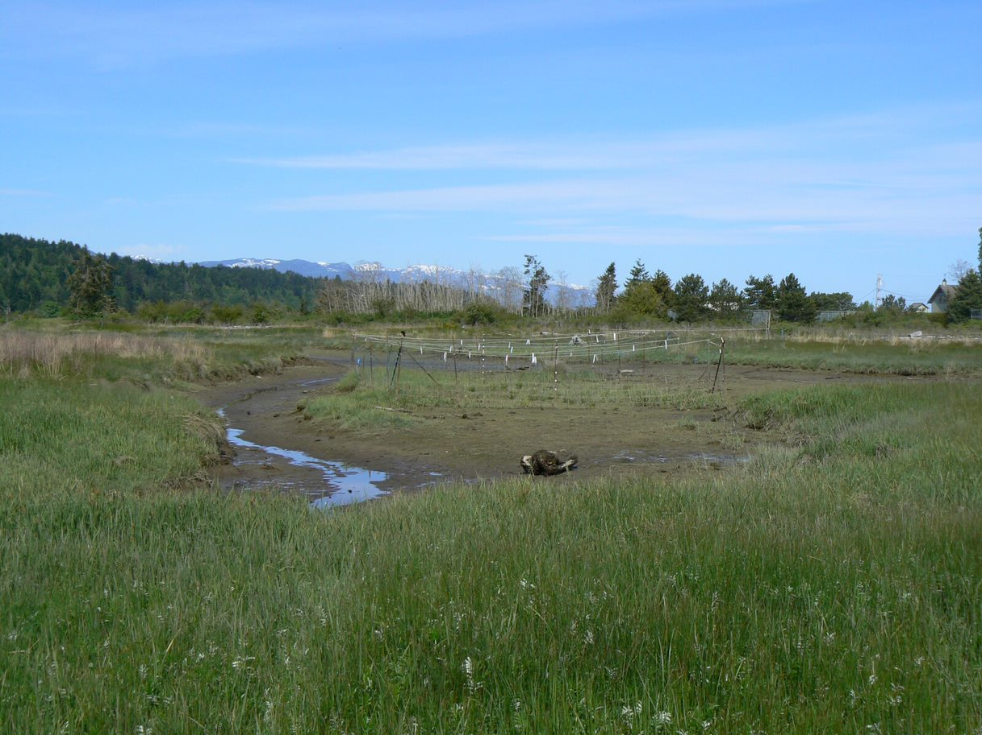
Example of ungrazed vegetation (foreground), composed of graminoids interspersed with Potentilla anserina. Exclosure in midground protects heavily grazed remnant vegetation. Note extensive vegetation loss along channel edge. Photo: Tim Clermont, 2012, Little Qualicum River Estuary

Slide 20
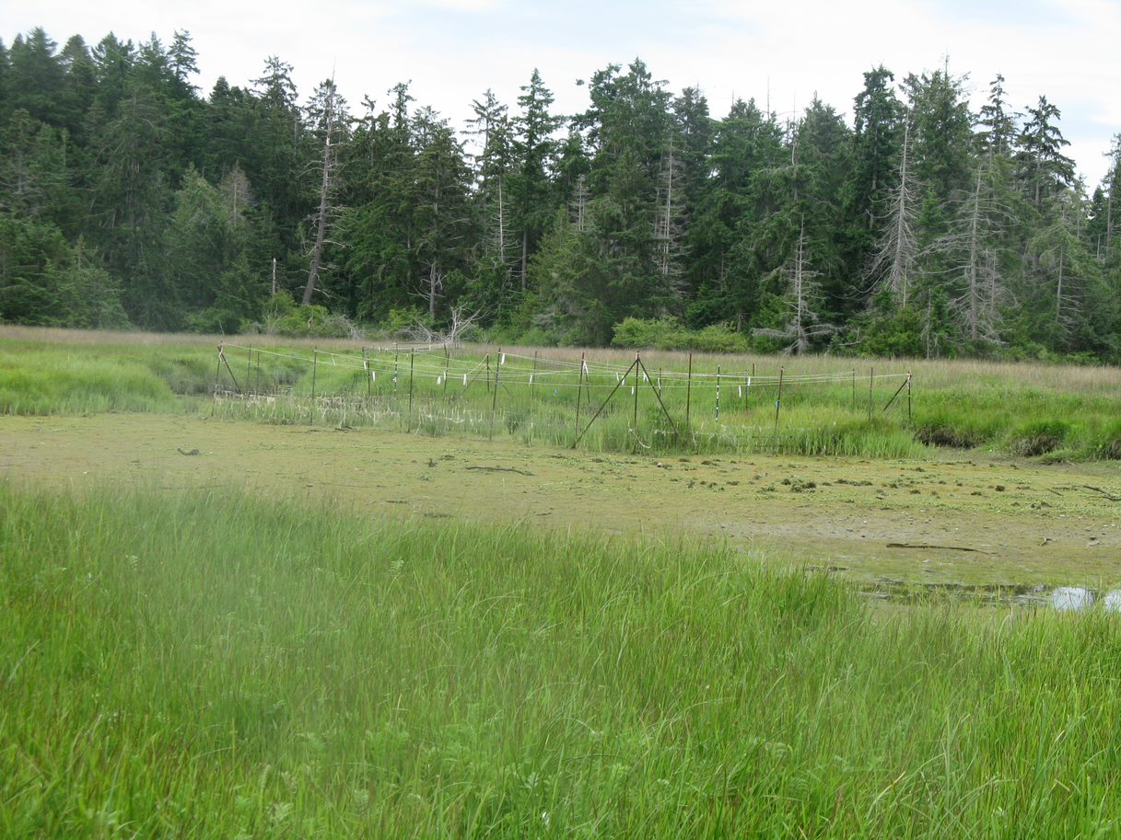
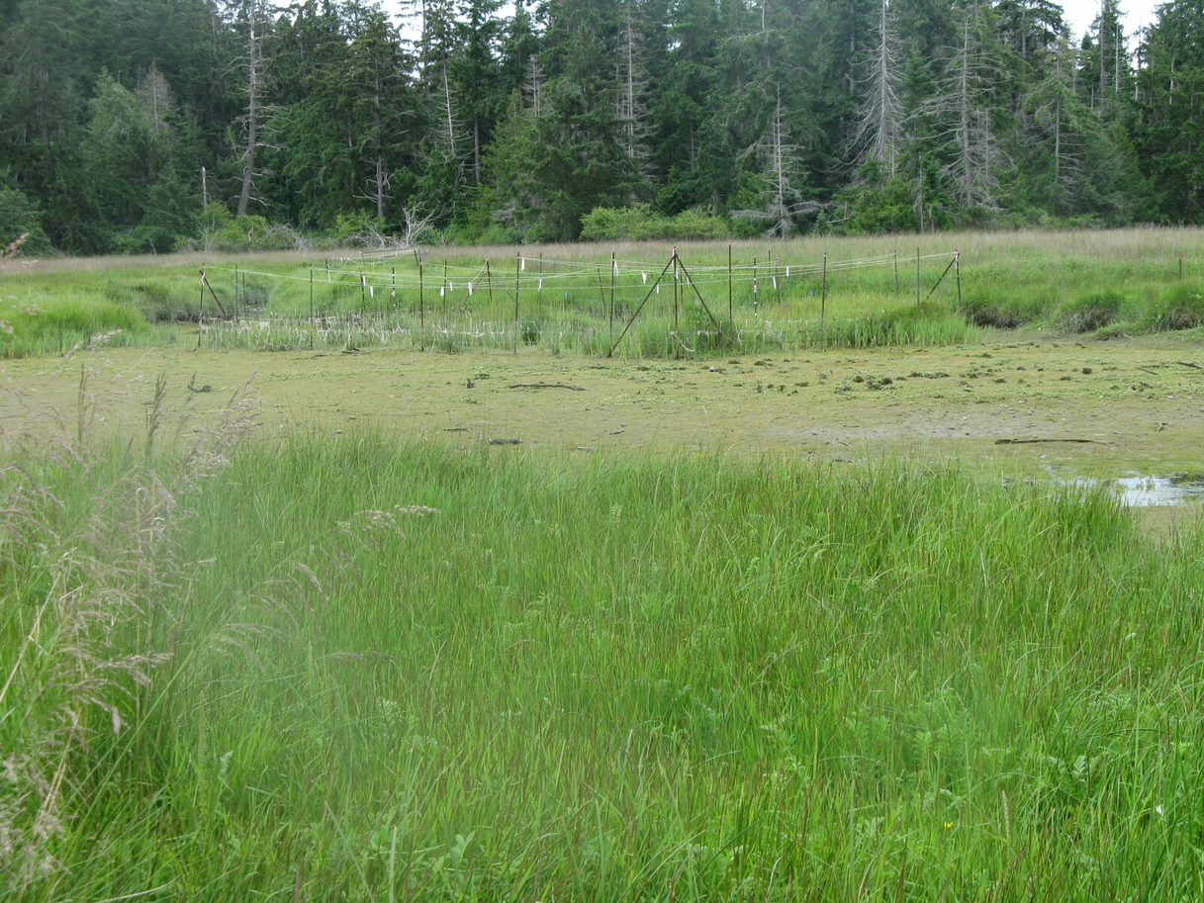
Img_2079, Img_2080 from Carex Restoration Photos > All Photos 2012
https://onedrive.live.com/?cid=99C6FD79FD59A126&id=99C6FD79FD59A126%211524&parId=99C6FD79FD59A126%211315&o=OneUp

Slide 21
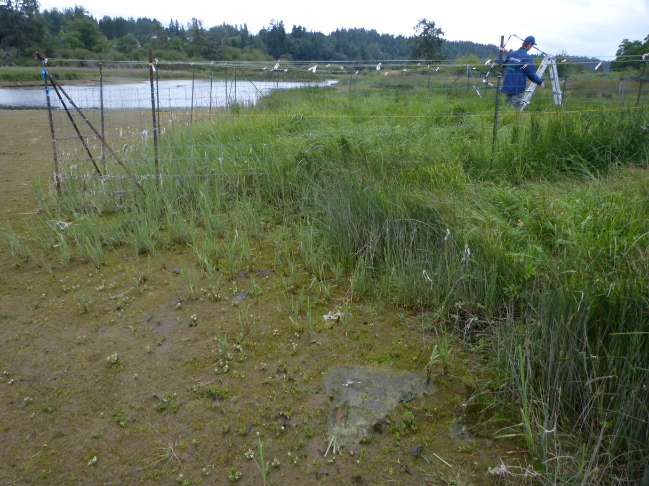
https://onedrive.live.com/?cid=99C6FD79FD59A126&id=99C6FD79FD59A126%213753&parId=99C6FD79FD59A126%213711&o=OneUp
Within Carex Restoration Photos > LQRE > Needs_Labels > LQRE 2013 at https://onedrive.live.com/?id=99C6FD79FD59A126%213711&cid=99C6FD79FD59A126

Slide 22
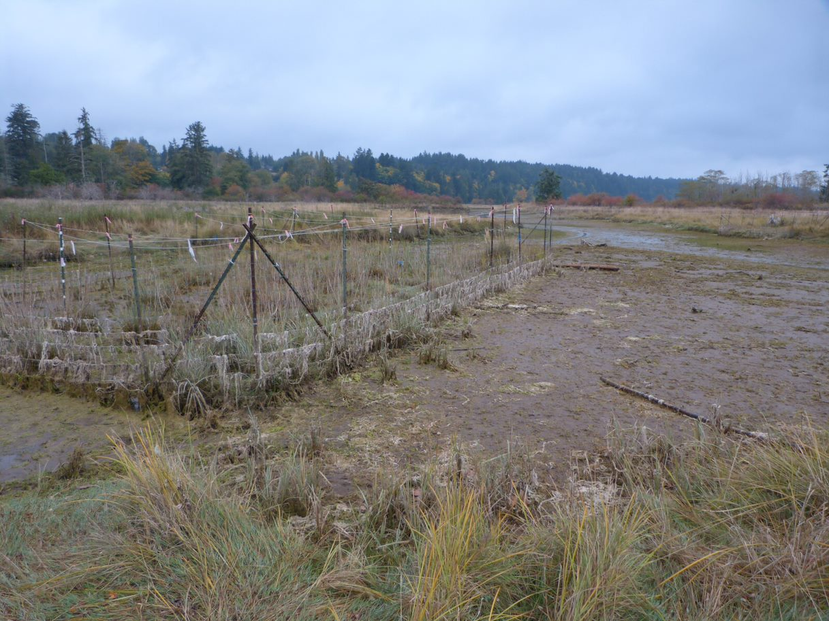
Possibly 10_08, looking across to 10_05??
Within Carex Restoration Photos > LQRE > Needs_Labels > LQRE 2013 at https://onedrive.live.com/?id=99C6FD79FD59A126%213711&cid=99C6FD79FD59A126

Slide 23
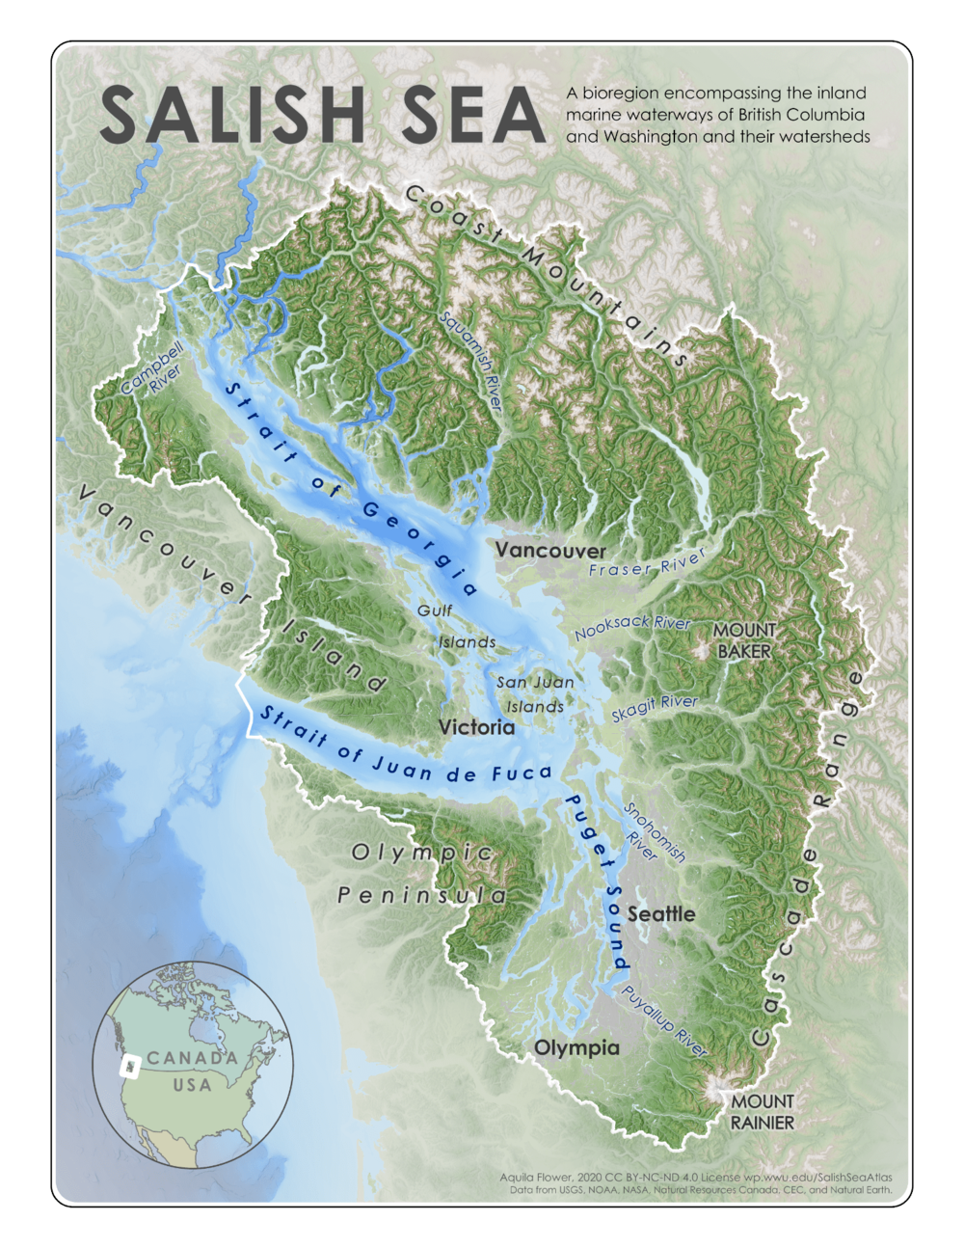
Aquila Flower, 2020
https://www.sealifer3.org/news/welcome-to-the-salish-sea

Slide 24
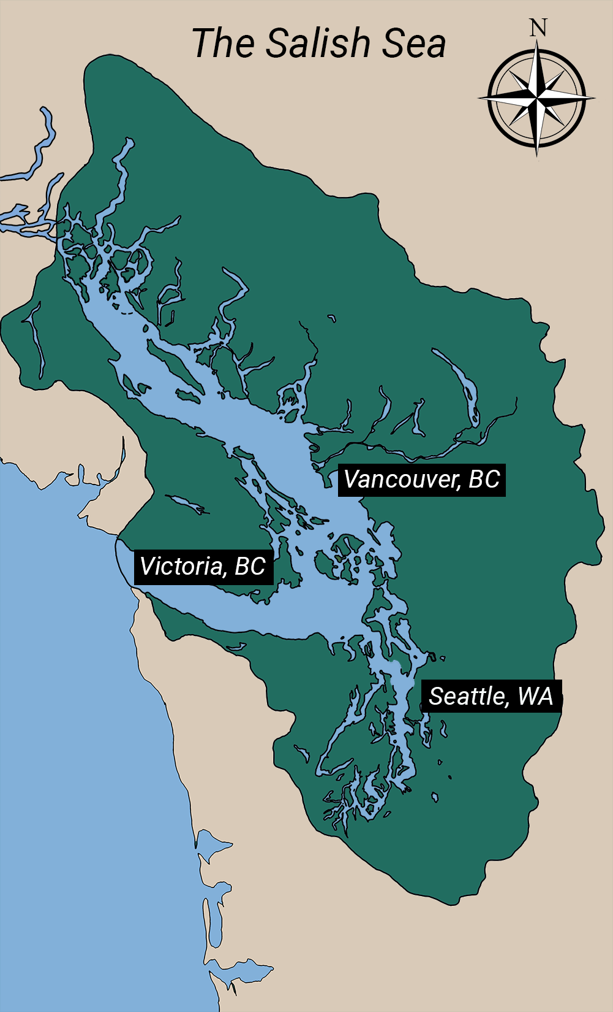
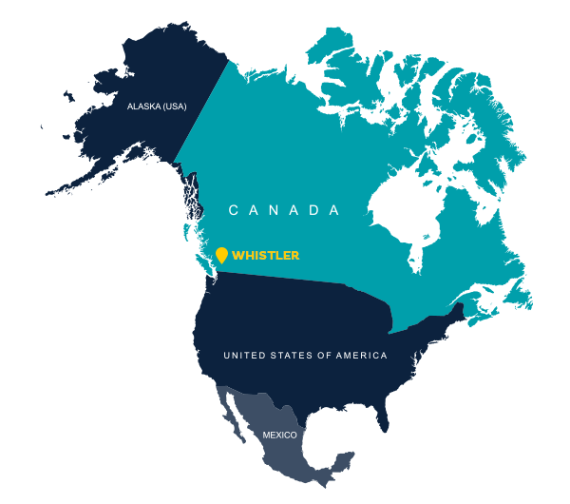
Little Qualicum River Estuary
Nanaimo River
Estuary
Notes:
Salish sea map: intothesalishsea.org/
North America map: https://www.whistler.com/getting-here/air/

Slide 25
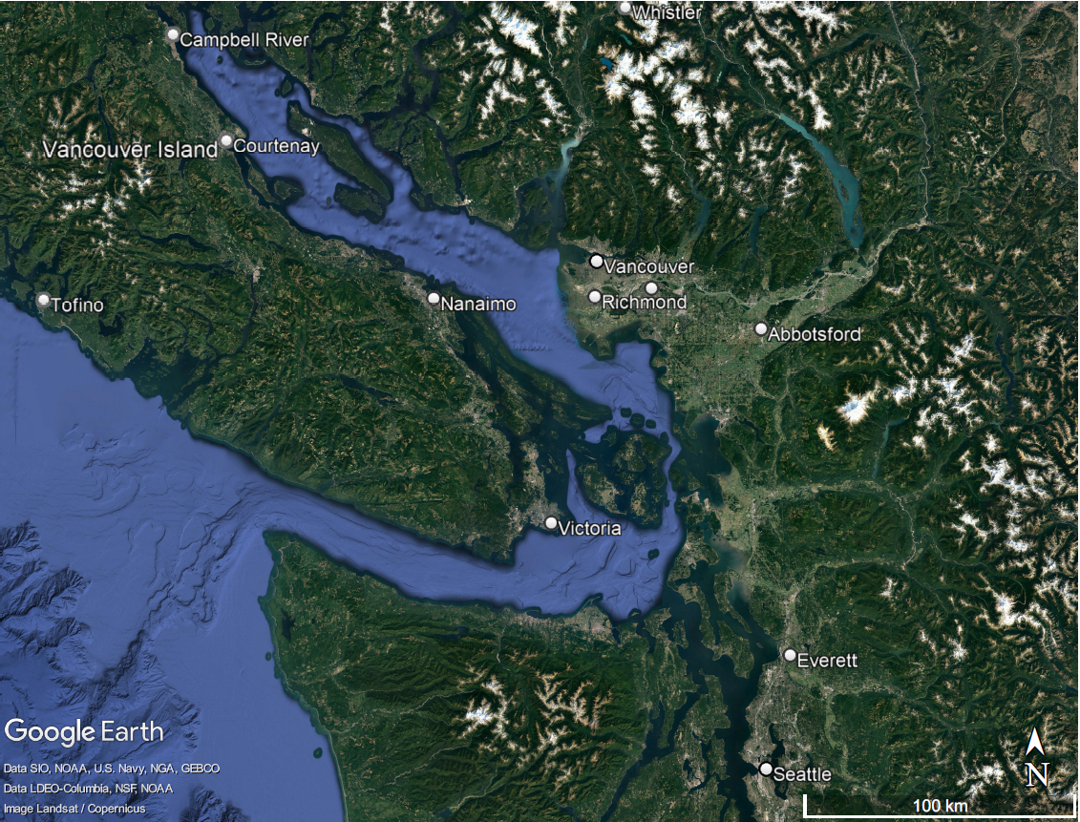
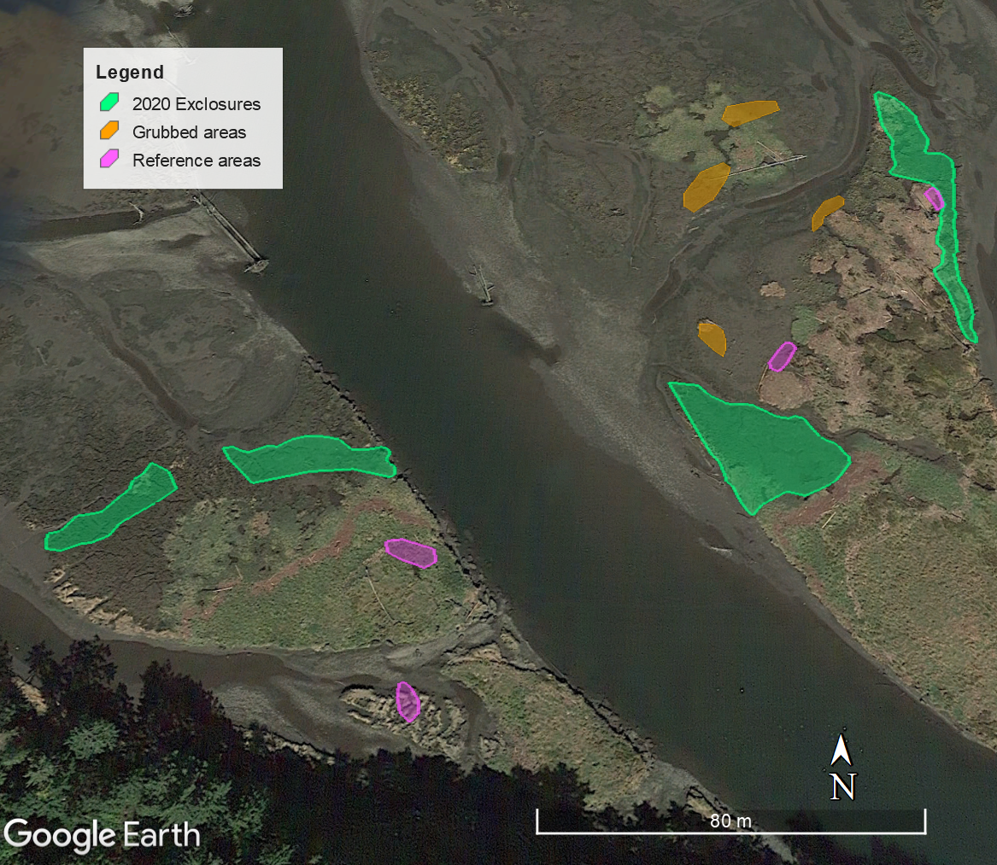
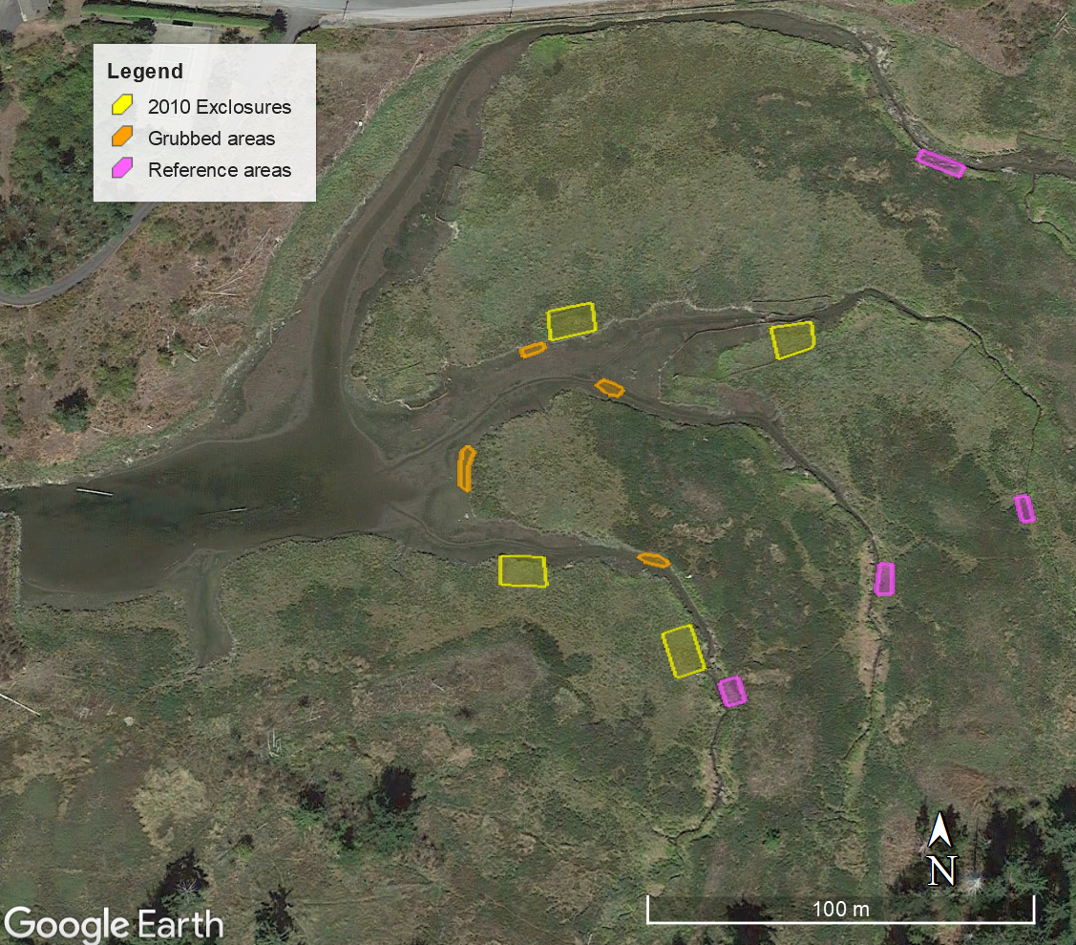
A
B
intothesalishsea.org
C
D

Slide 27
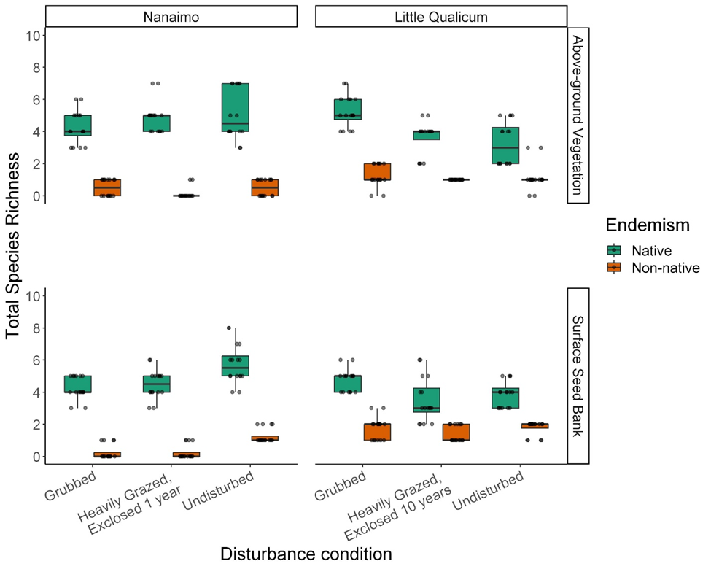
Notes:
Species richness of native vs. non-native plants was even among disturbance categories in both Nanaimo and Little Qualicum River Estuaries for both above-ground vegetation and surface seed banks.

Slide 28
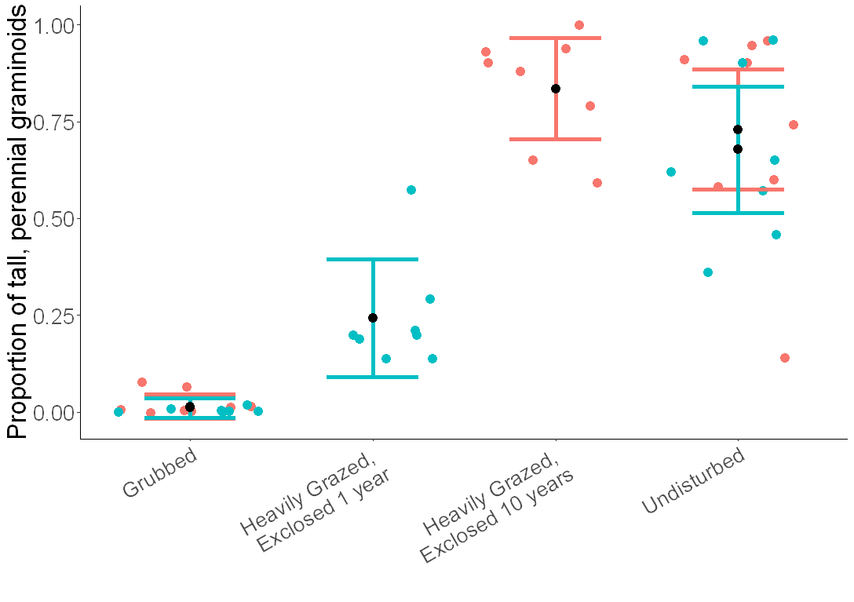
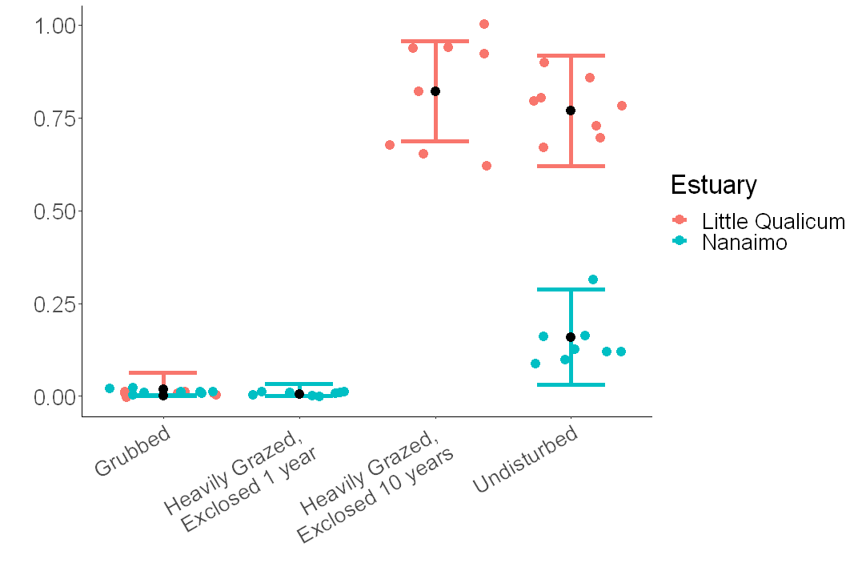
Above-ground Vegetation
Surface Seed Banks

